Slide 1





Analyzing pool of diseases using Machine Learning algorithms.
Team 3
Tanmay Zope | 002767087
Saloni Rane | 002756771
Shreeyash Lahane | 002743020
Parth Kalani | 002766306

Slide 2

Table of contents:
Problem Statement
Dataset Description
Data Preprocessing
Logistic Regression
KNN
Decision Tree Classification
Random Forest Classification
Support Vector Machine Classification
Naïve Bayes
Implementation & Code Snippets
Results and Visualizations
Performance Evaluation
Conclusion

Slide 3
Problem Statement
Analyze large amounts of medical data, identify patterns, and use this information to make predictions to improve the accuracy and speed of disease diagnosis
Thereby helping medical professionals to provide better care and treatment to patients. Thus, enabling medical professionals to significantly streamline the process.
Developing models and choosing the most optimal one that accurately classifies risk using a more automated approach and greatly impacting chronic disease prediction

Slide 4
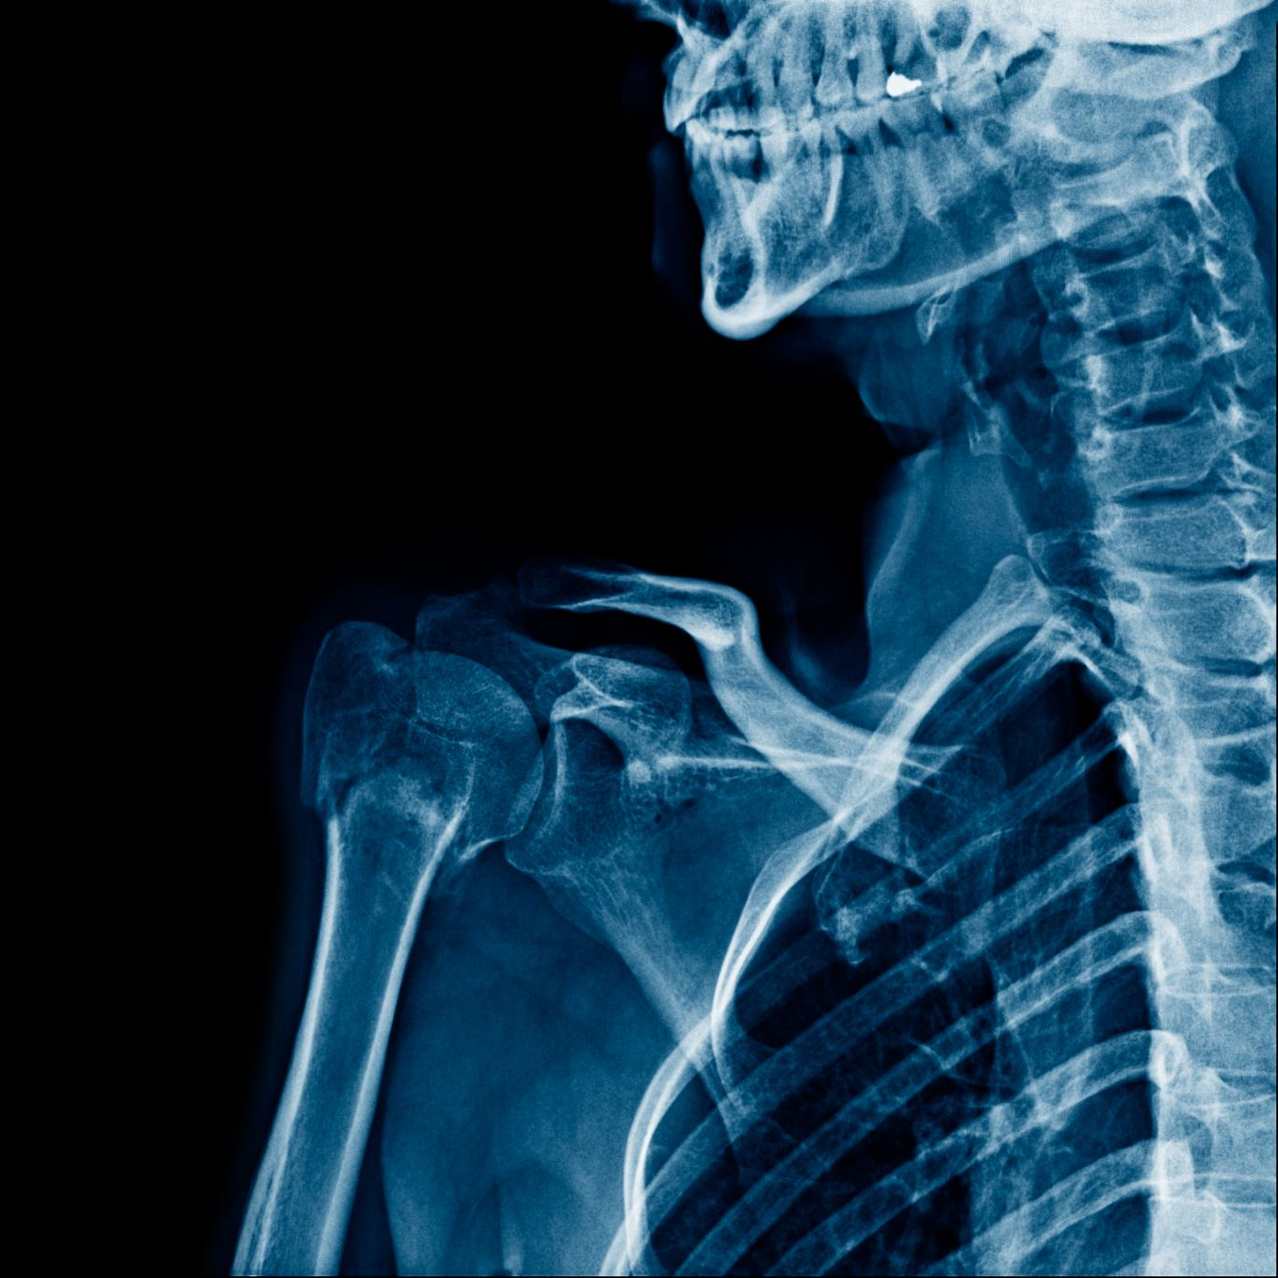
Data Description
The Complete Dataset includes two CSV files - one for training your model and the other for testing it.
Each CSV file contains 133 columns, with 132 columns representing different symptoms experienced by a person and the last column indicating the prognosis.
These symptoms are linked to 42 different diseases, which can be classified based on the set of symptoms.

Slide 5

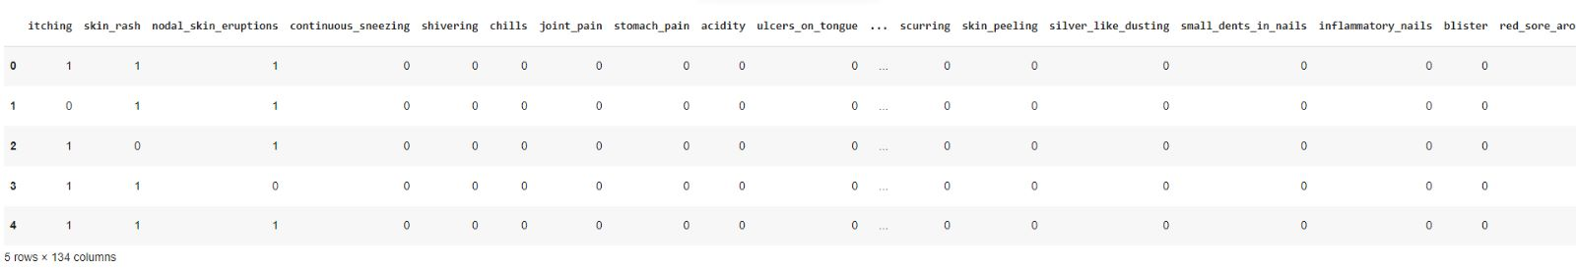
Data Description
Dataset

Slide 6

Technical Approach
The steps listed below were used to apply five different machine learning approaches for categorization on the provided dataset:
Load the datasets
Pre-processed the data by eliminating any irrelevant columns or features that could not be helpful for the categorization process.
Implemented feature scaling & data cleaning.
Divide the training dataset into subsets for training and validation to evaluate the effectiveness of the machine learning models.
Use the training dataset to apply different machine learning approaches for classification, including SVM and decision trees. Among other models we included logistic regression, k-nearest neighbors, random forest, and naive Bayes
Used relevant evaluation metrics, such as accuracy, precision, recall, and F1-score, to assess each model's performance on the validation subset.

Slide 7

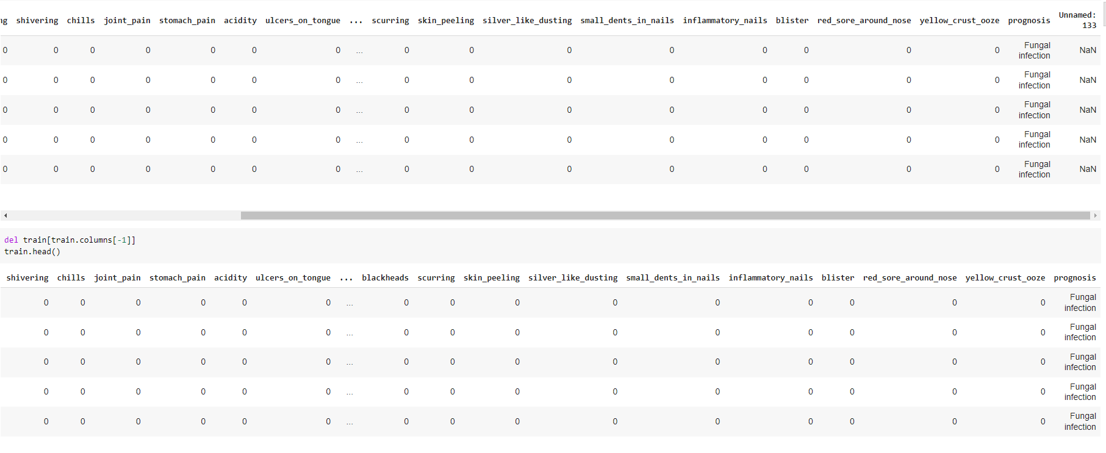
Data Preprocessing
Displaying the first 5 rows of the dataset
Dropping the last column as it has redundant values

Slide 8
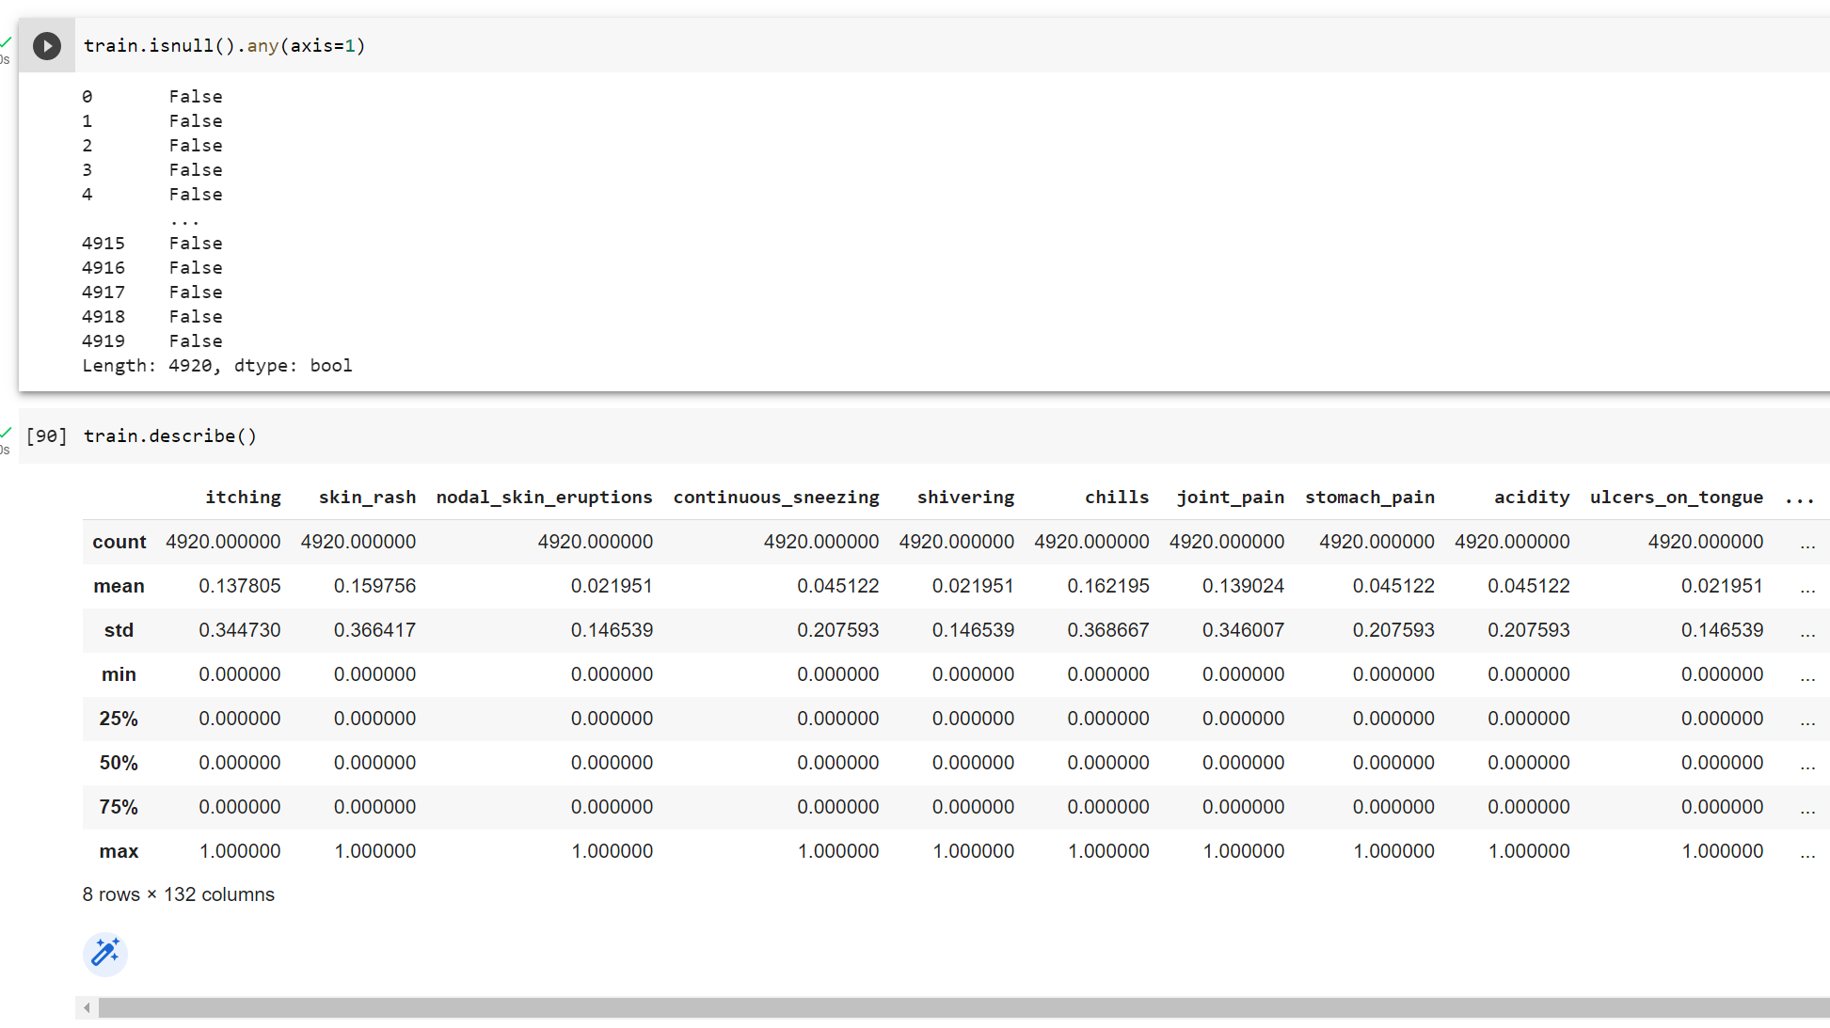
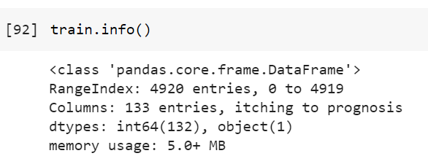
Data Preprocessing
Checking the null values per row
Check the description of DataFrame
Displaying basic information of DataFrame

Slide 9
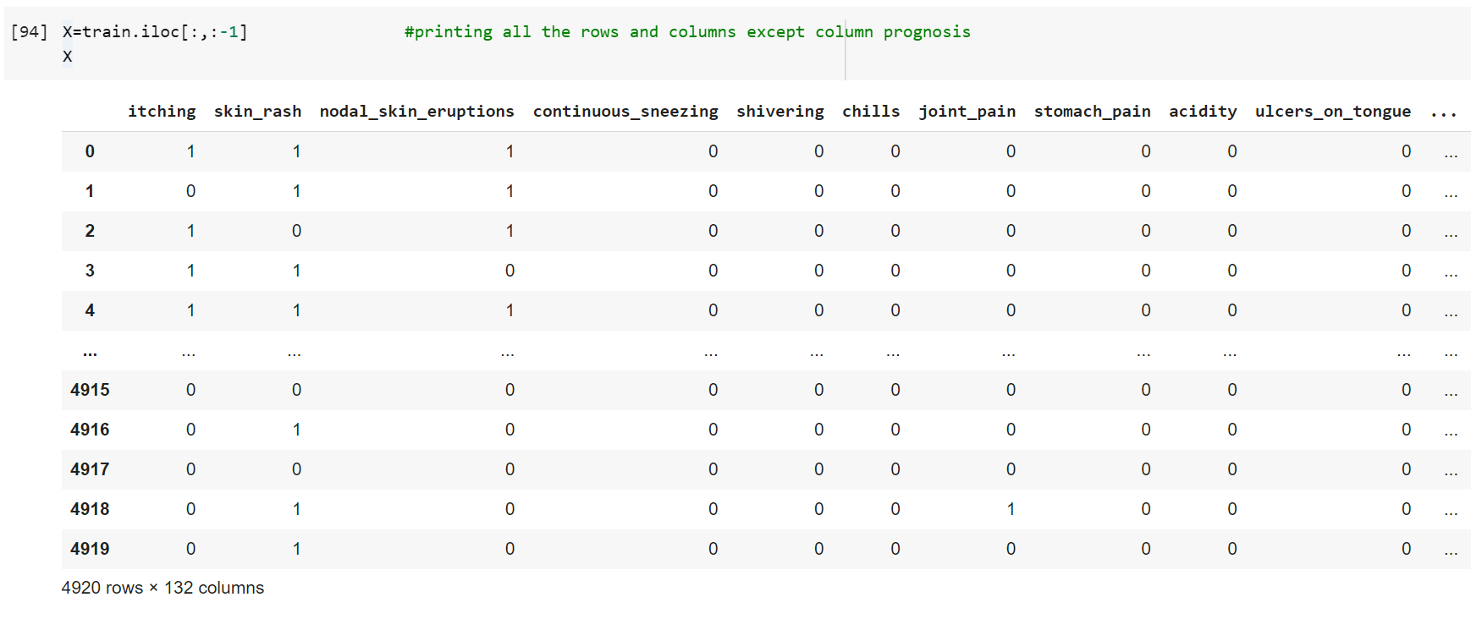
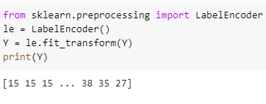
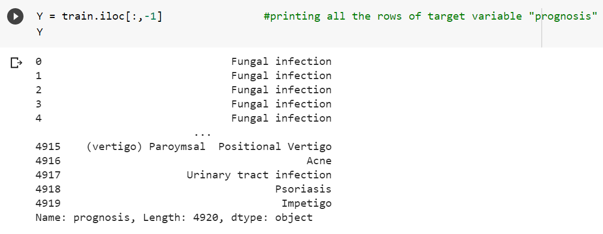
Data Preprocessing
Assigning the feature columns to X and Target variable to Y
Performed Label Encoding on target variable to covert categorical values to numerical values

Slide 10
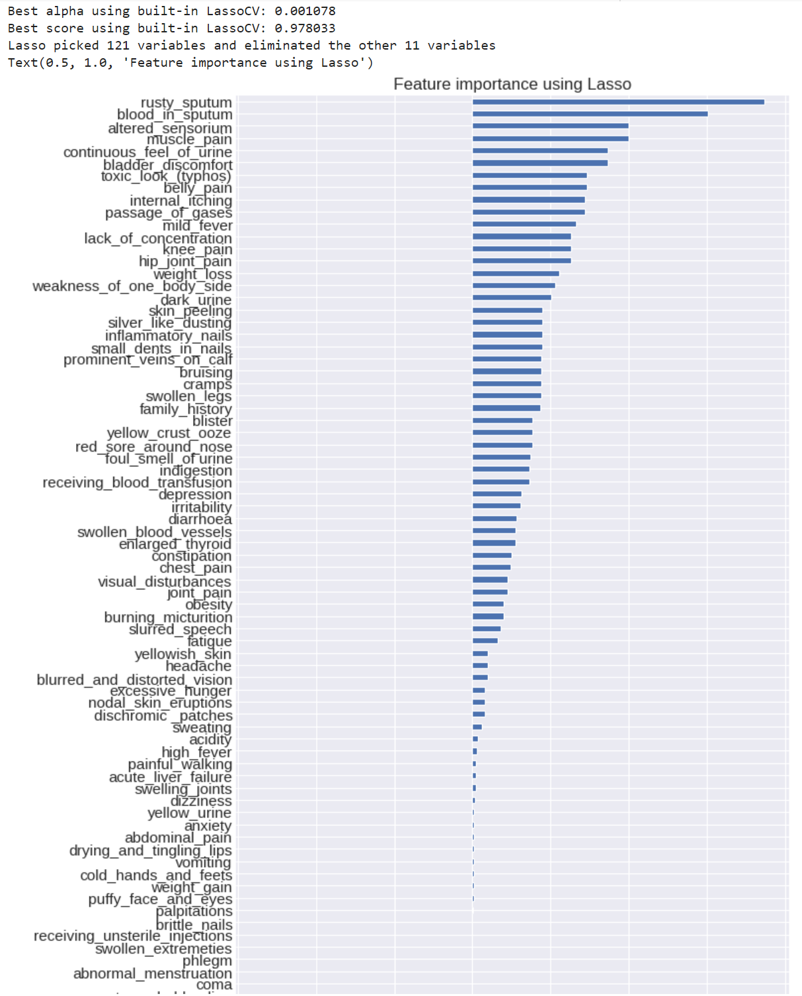
Feature Selection
We implemented Lasso regularization for feature selection.
It adds a penalty term to the objective function of the regression model
Penalty term is proportional to the absolute values of the model coefficients and it shrinks the coefficients towards zero
We took the best value of alpha and the best score obtained.
The coefficients of the Lasso model are computed and used to identify the most important features, which are visualized using a horizontal bar chart.

Slide 11
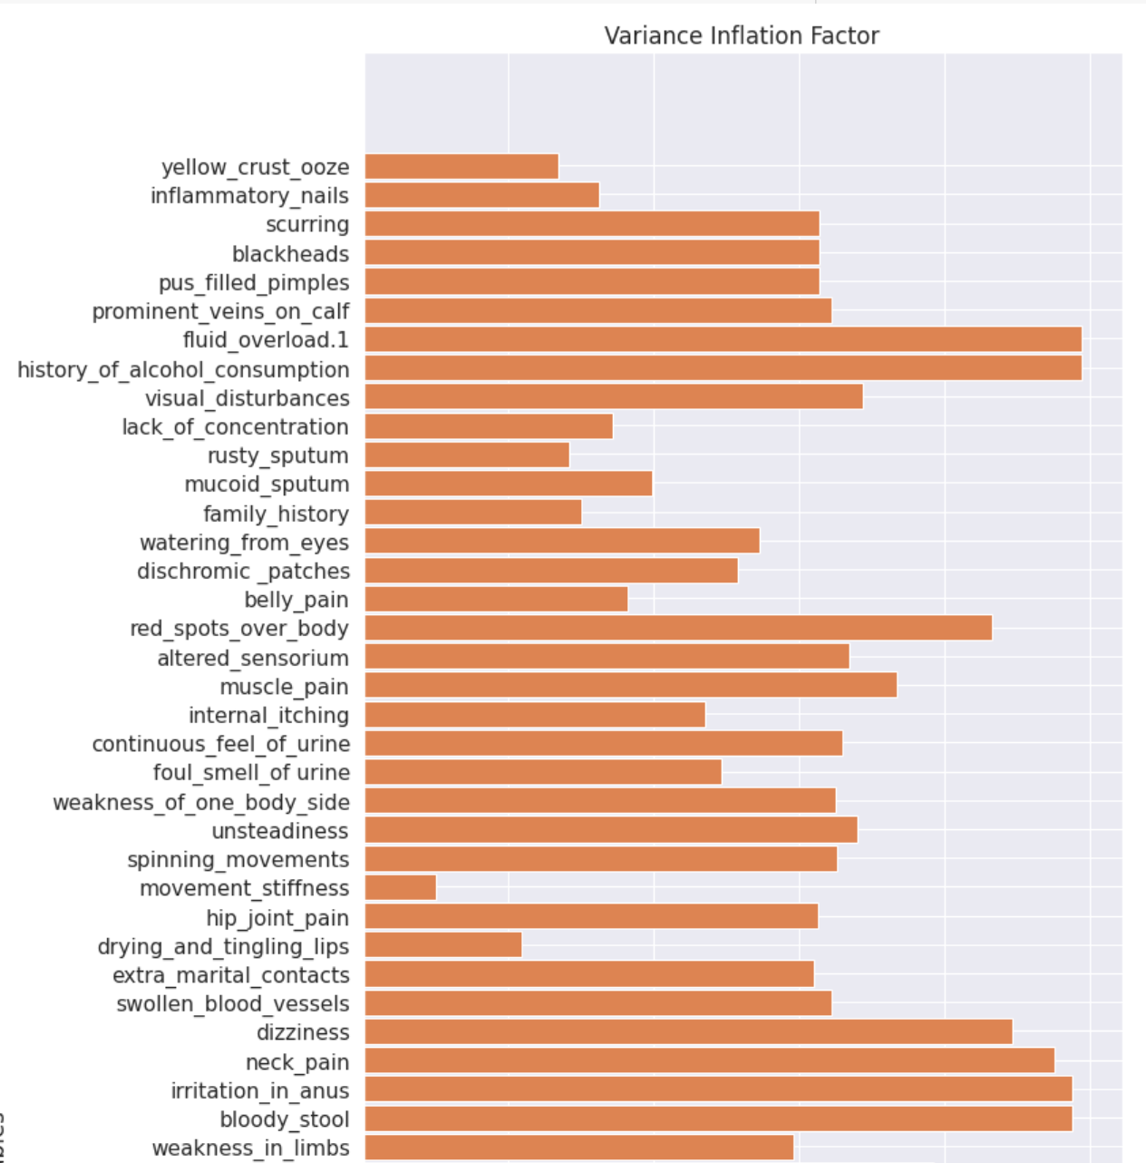
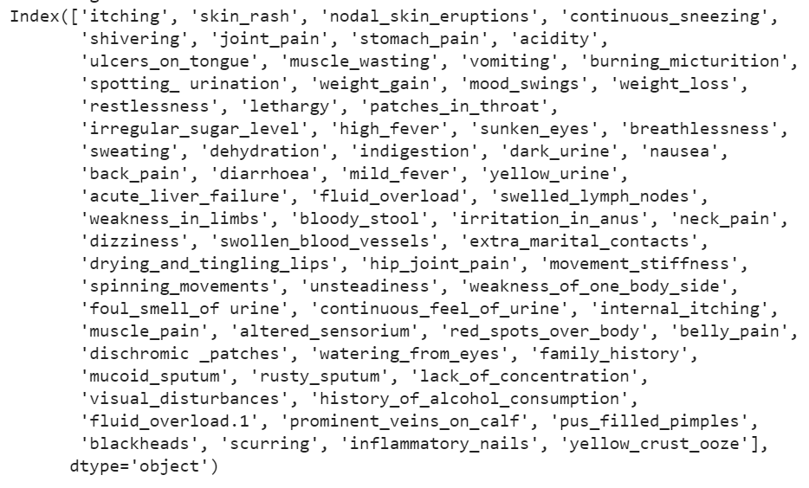
Feature Selection
The Variance Inflation Factor is a measure of the extent to which the variance of the estimated regression coefficient is inflated due to multicollinearity among the independent variables in a regression model.
It was used to identify and remove highly correlated features using the VIF metric,
If the highest VIF value is above the specified threshold, it was dropped from the variables list.
Then we iterated a loop where all remaining variables with VIF values below the threshold were selected.
Finally, this process returned a subset of the original dataset that contained only the remaining variables with low VIF values.

Slide 12
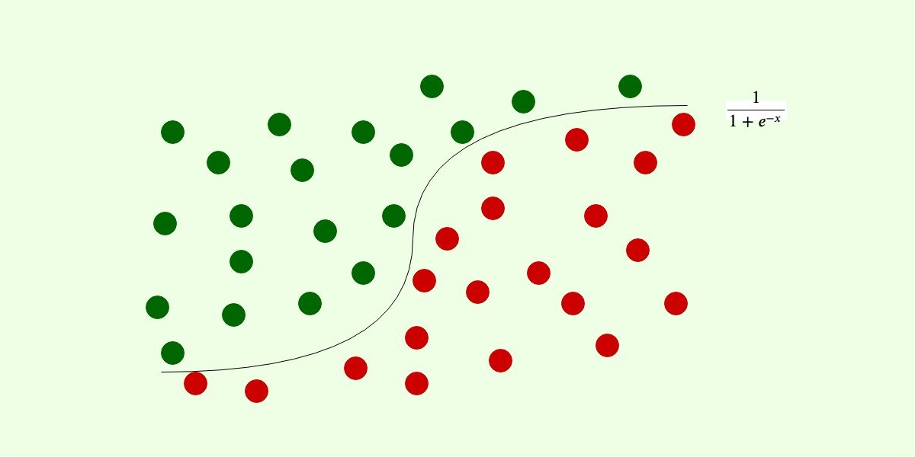
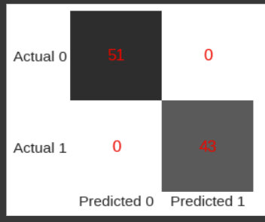
Logistic Regression
Supervised machine learning model
It is a classification model – used to predict a small number of outcomes
Applying label encoding on the target variable (Prognosis)
Performing Categorical Logistic Regression as Response variable is categorical
Model Accuracy obtained with disease prediction dataset
= 89.63 %
Confusion Matrix Obtained

Slide 13
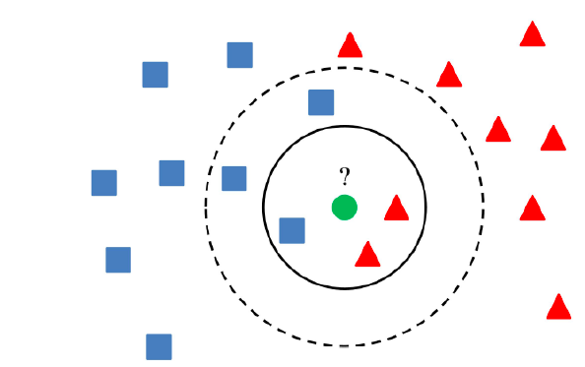
K – Nearest Neighbor
Supervised machine learning model
Calculates distance between test instance and all training examples
Right distance metric and feature scaling can improve the performance
Model Accuracy = 88.82%
Use for Classification and Regression
Makes Predictions based on the k-nearest training examples

Slide 14
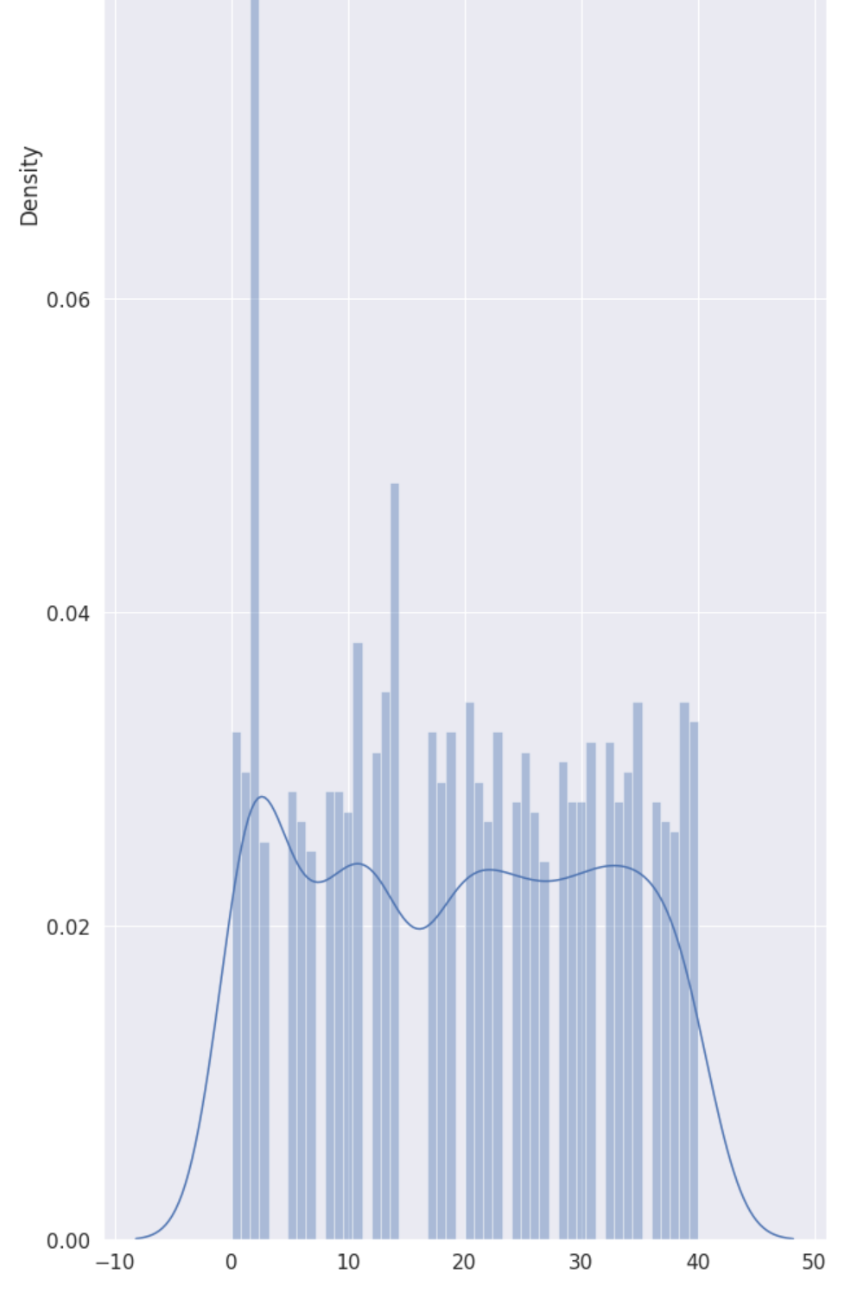
Data Visualization of KNN Distplot – Predicted values of y (yPred)
visualization of the distance distribution between the query location and its k-nearest neighbors.
Model Accuracy for
Disease dataset
= 88.82%

Slide 15
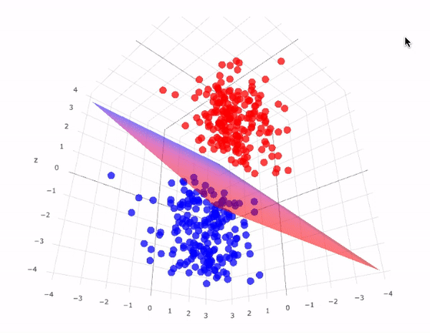
Support Vector Machine
Algorithm for classification, regression, and outlier detection using supervised machine learning
The SVM algorithm seeks to maximize the distance between each class's closest data points and the hyperplane.
SVM outputs a hyperplane that best separates the provided points using the currently available data points. decision-making limit
The closest element's greatest distance from the best hyperplane is
For large datasets, SVMs can be computationally expensive.
Model Accuracy:
Linear-89.63
RBF-88.87
Poly-83.53

Slide 16
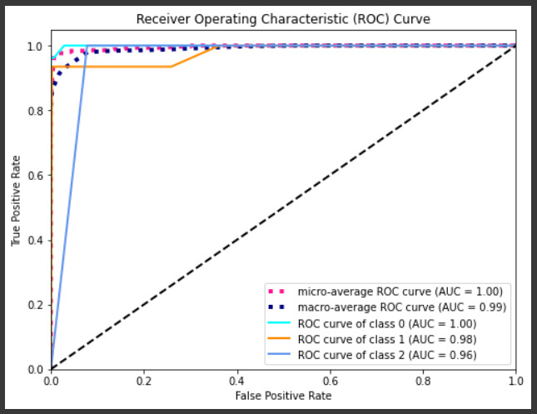
Data Visualization of SVM - ROC Curve (True Positive vs. False Positive)
At various classification thresholds, the ROC curve illustrates the trade-off between the true positive rate (sensitivity) and the false positive rate
(specificity).
Model Accuracy for Disease Dataset:
Linear = 89.63 % (AUC = 1)
RBF = 88.87 % (AUC = 0.98)
Poly = 83.53 % (AUC = 0.96)

Slide 17

Decision Tree
Type of Supervised learning model which uses Rule-based approach
Splits the predictor space into subgroups based on their similarity
Variable Selection criterion: Entropy/Information Gain & Gini Index
Higher information gain, better split.
Accuracy: 89.63%

Slide 18
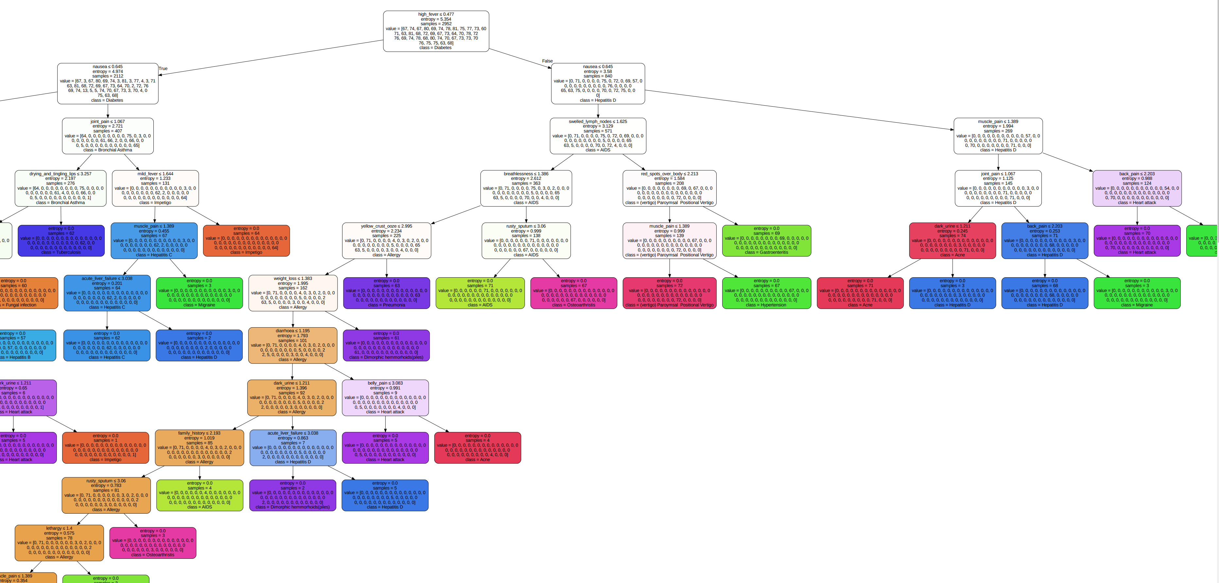
Data Visualization of Decision Tree

Slide 19
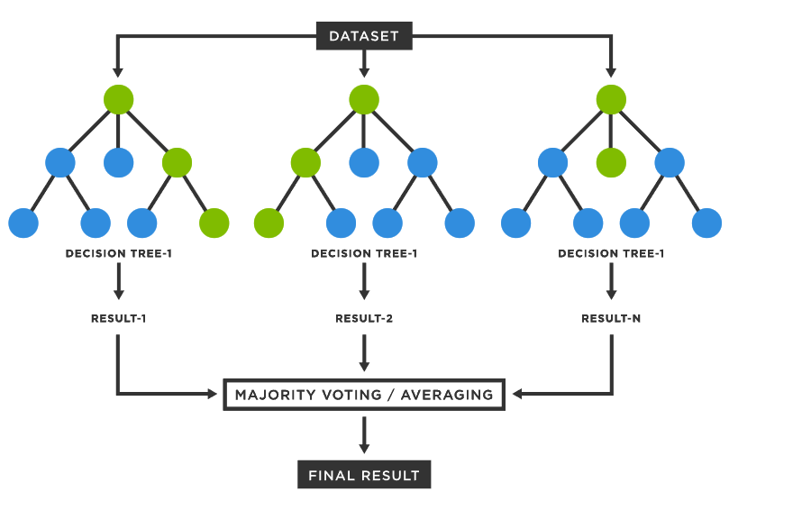
Random Forest
Large number of individual decision trees
Combination of Uncorrelated models
More number of uncorrelated outcomes are better
Accuracy: 89.63%

Slide 20
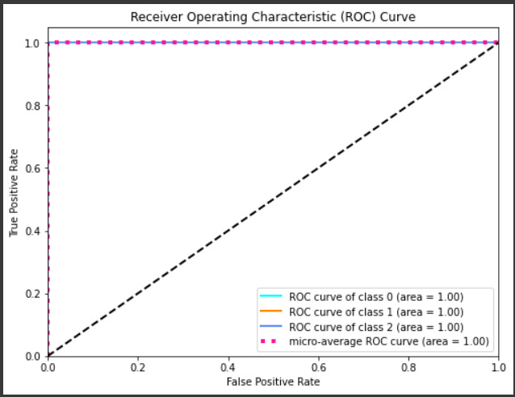
Data Visualization of Random Forest

Slide 21
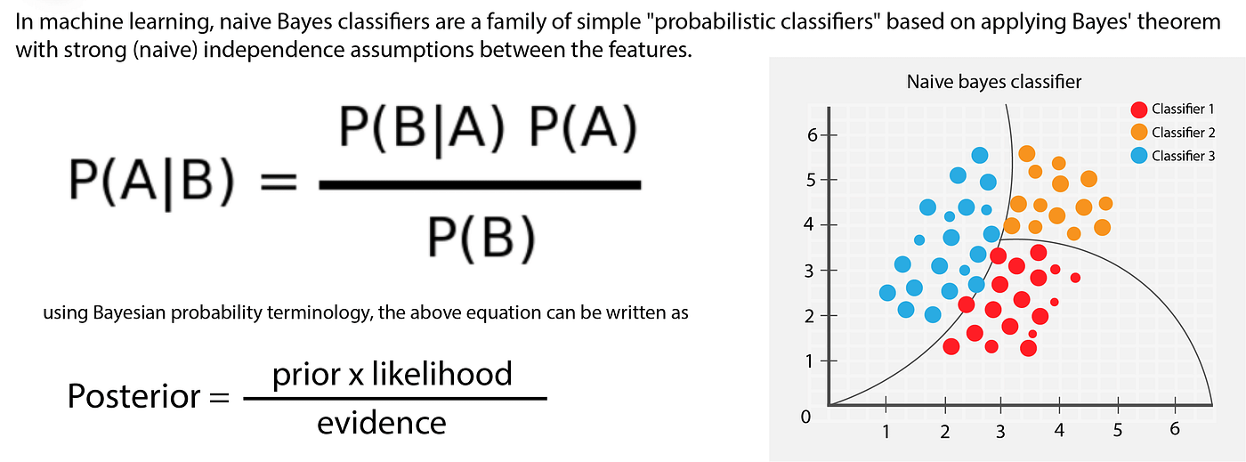
Naïve Bayes
Type of Supervised learning model which uses Probabilistic approach
Naïve bayes assumes all variables are independent of each other
Very fast analysis
Accuracy: 89.07

Slide 22
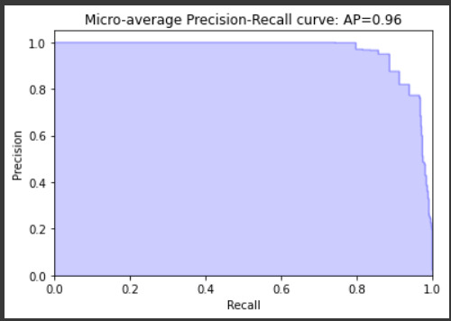
Data Visualization of Naïve Bayes (Precision Recall Curve)

Slide 23
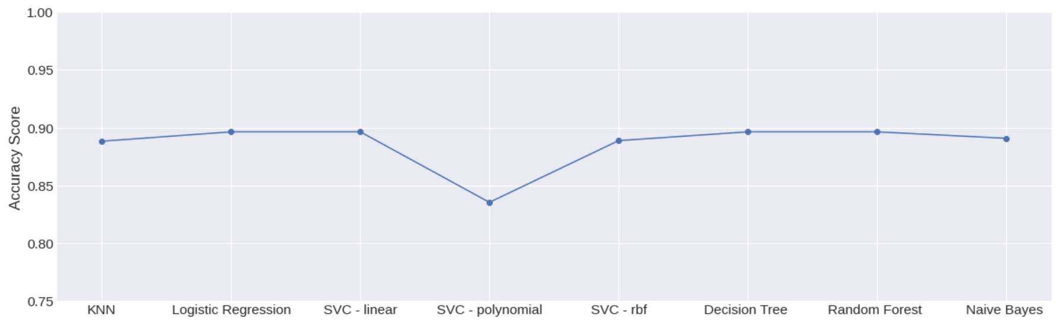
Results - Performance Comparison
 | Logistic Regression | KNN | SVM | Decision Tree | Random Forest Classifier | Naïve Bayes
Accuracy (in%) | 89.63 | 88.82 | Linear-89.63 RBF-88.87 Poly-83.53 | 89.63 | 89.63 | 89.07

Slide 24

Conclusion
Based on these scores, Logistic Regression, Decision Tree, and Random Forrest have the highest accuracy scores of 89.6%.
SVM with a linear kernel also has a high accuracy score of 89.6%.
Naïve Bayes has a slightly lower accuracy score of 89%, while KNN and SVM with a polynomial kernel have the lowest scores of 88.8 and 83.5, respectively.
Therefore, if we are to choose a single model based on accuracy alone, we would likely choose Logistic Regression, Decision Tree, or Random Forrest.
However, it's important to keep in mind that accuracy is not the only metric to consider, and other factors such as model complexity and interpretability may also be important.

Slide 25
Thank you!

